Slide 1
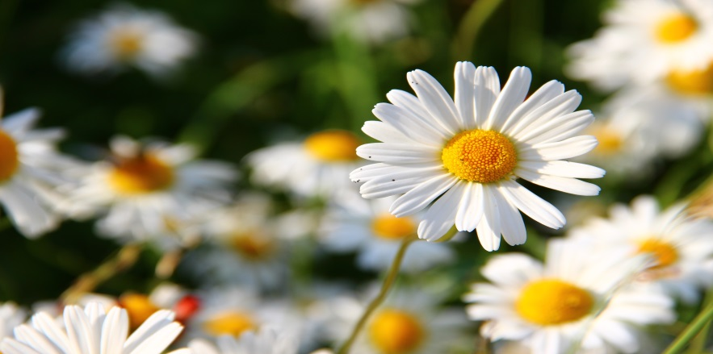
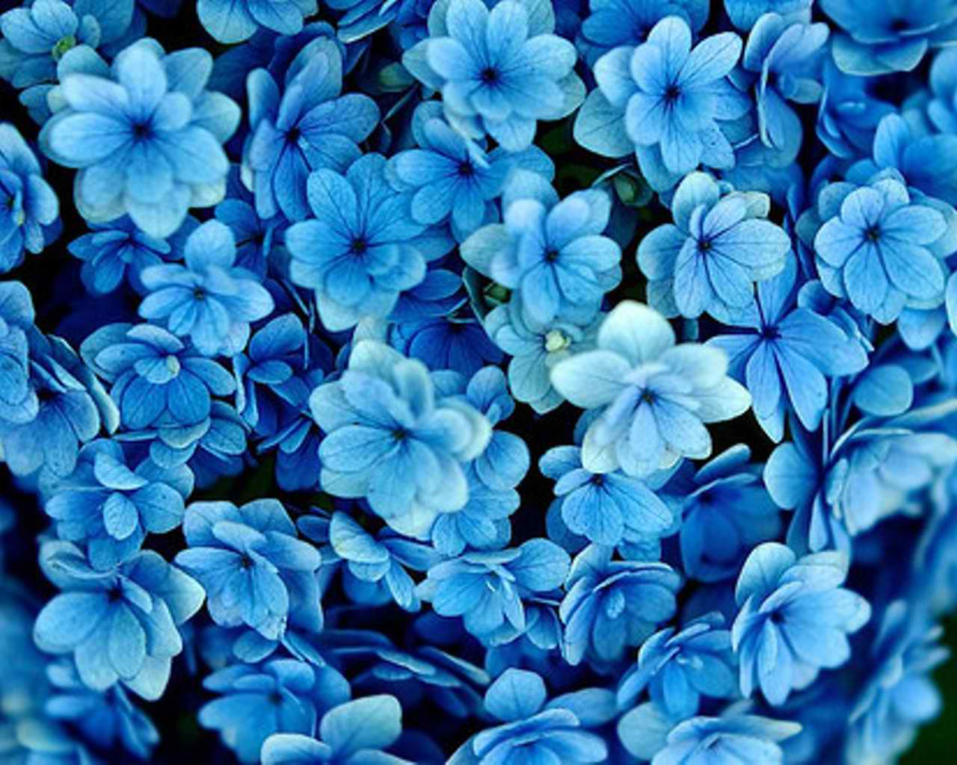
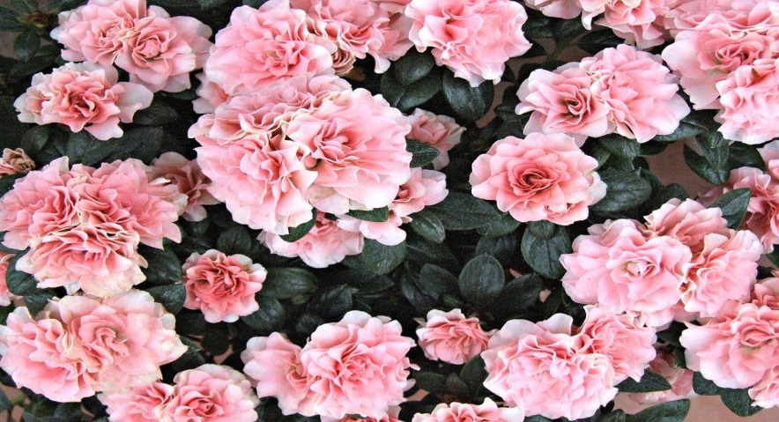
BRILLIANT BOTANY
For this week’s Science Challenge we are looking at plants.

Slide 2
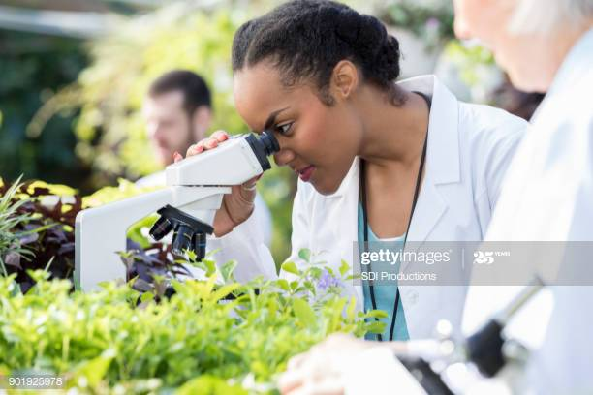
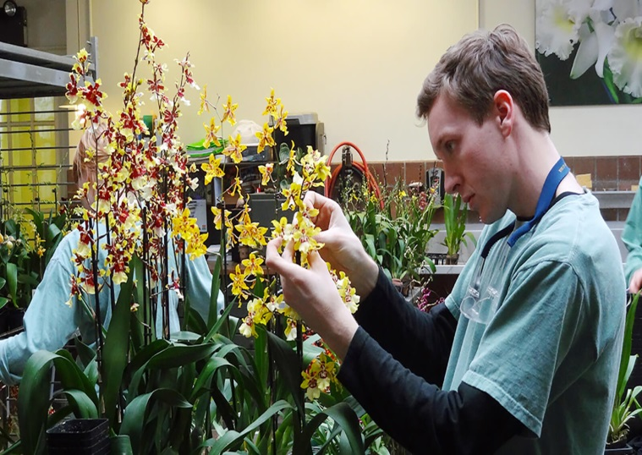
What is a Botanist?
Explain what botanists do and why their work is important.

Slide 3
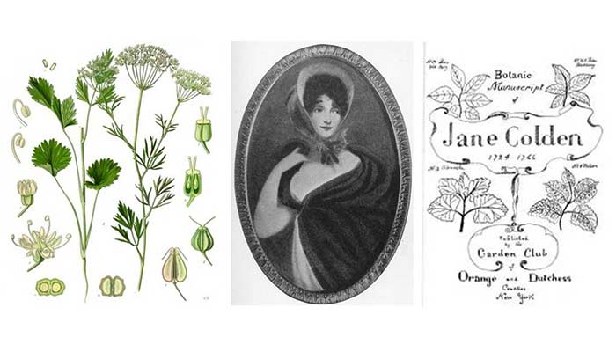
Who is Jane Colden?
Use the internet to find information about Jane Colden and describe her life and work .

Slide 4
Become a Botanist!
Children – go out into your garden and look at the range of plants.
Use a magnifying glass to closely observe different parts of one of the plants and sketch the different parts.
Who can observe the parts of plants really closely and who can identify the different parts and label them?

Slide 5
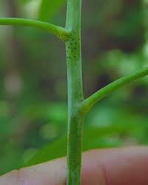
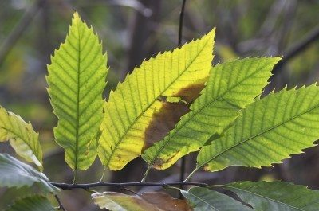
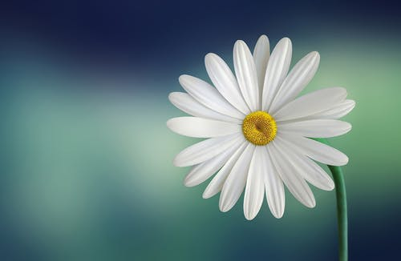
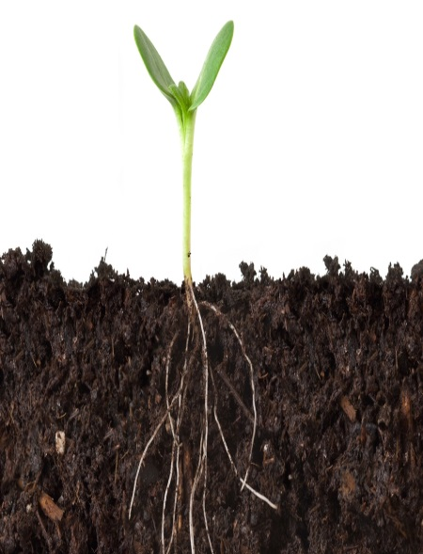
Become a Botanist – Challenge!!
Can you now write a short explanation of what each part of a plant does?
Why are flower petals so colourful?

Slide 6
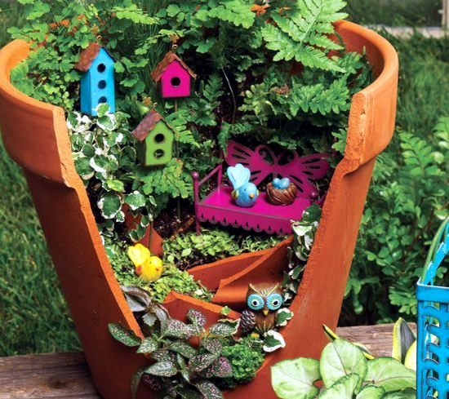
Other Activities You Could Do:
Choose your favourite plants to plant a small miniature garden for a small
area in your garden.
OR
Use a window box or large plant pot
to create a miniature garden inside
and place the garden on a windowsill or
in an area in your garden.

Slide 7
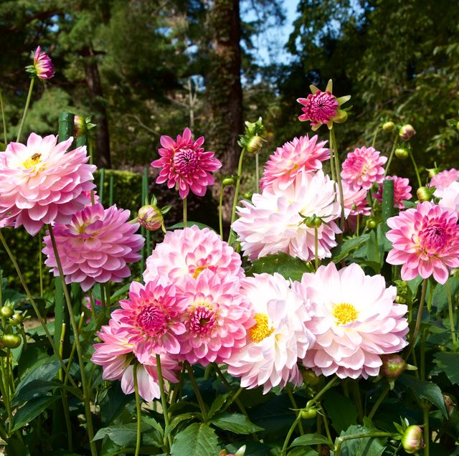
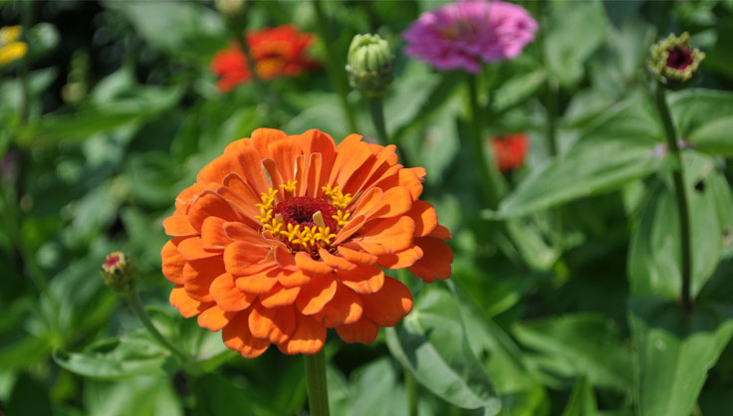
Other Activities You Could Do:
Visit a relative’s garden if you can or a local garden centre with your parents.
Identify or sketch the different parts of the plants you can see.

Slide 8
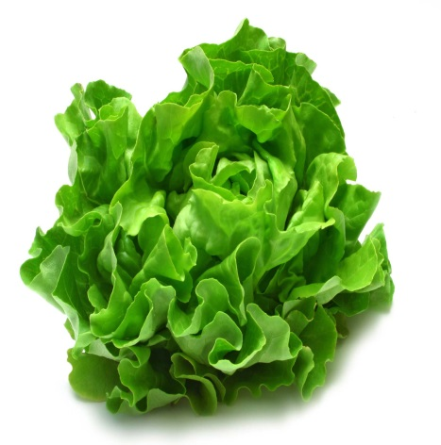
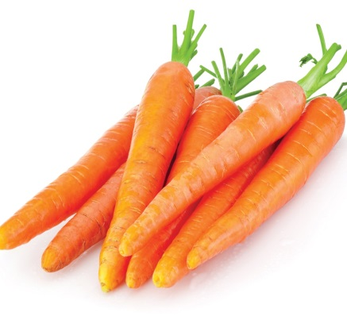
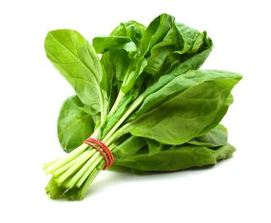
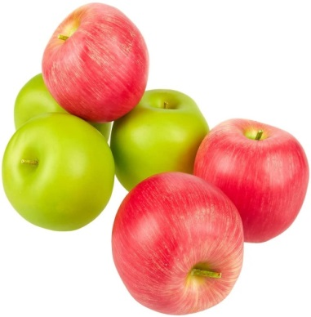
Other Activities You Could Do:
Within your family you could vote on your favourite plants to eat!
Make a graph or chart together to display your choices. Choose from plants such as lettuce, spinach, peas, carrots or apples etc.

Slide 9
Finally …
Please send in any sketches, work, photos, videos to our email: virtual@beaudesert.school
I look forward to seeing how you get on at being a botanist!
Happy investigating.
Mrs Butcher ☺

