Slide 1
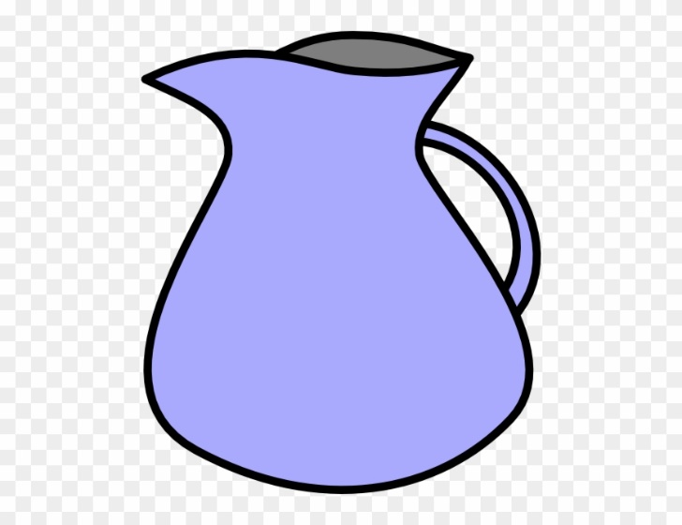
Activity sheet one for spelling
NB – words are sun, box & jug

Slide 2
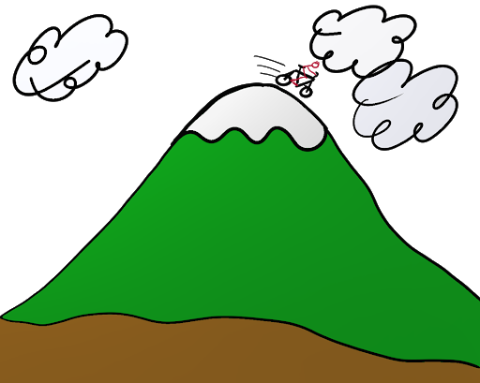
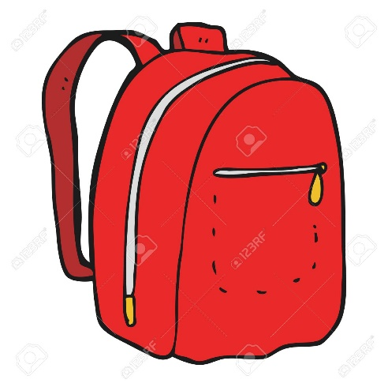
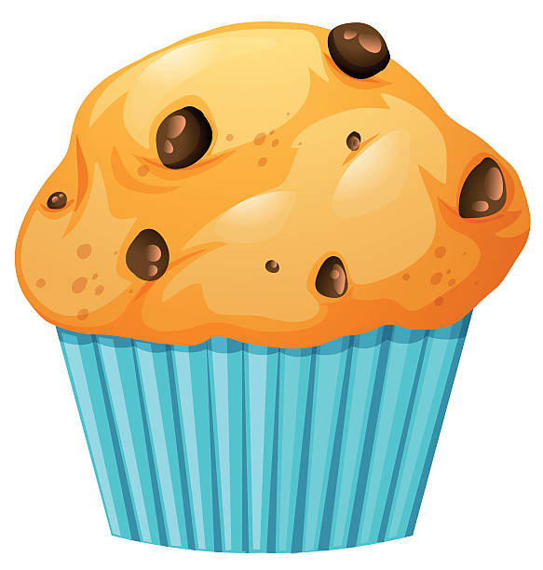
Activity sheet two for spelling
NB there are only 5 boxes to represent 5 sounds. Therefore in ‘muffin’ – the ff is one sound so must be in one box.

Slide 3
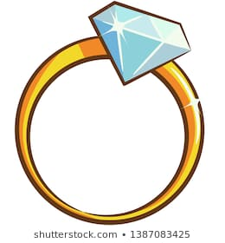
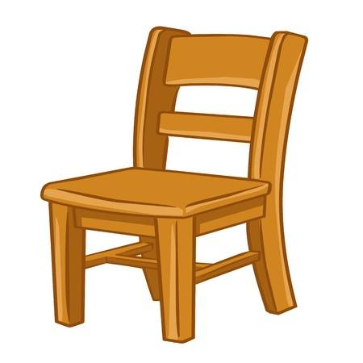
Activity sheet three for spelling
NB – remember digraphs and trigraphs represent one sound so they all go in one box. The words are – ring, beard, chair & ship

